Slide 1
Anaesthesia

Slide 2
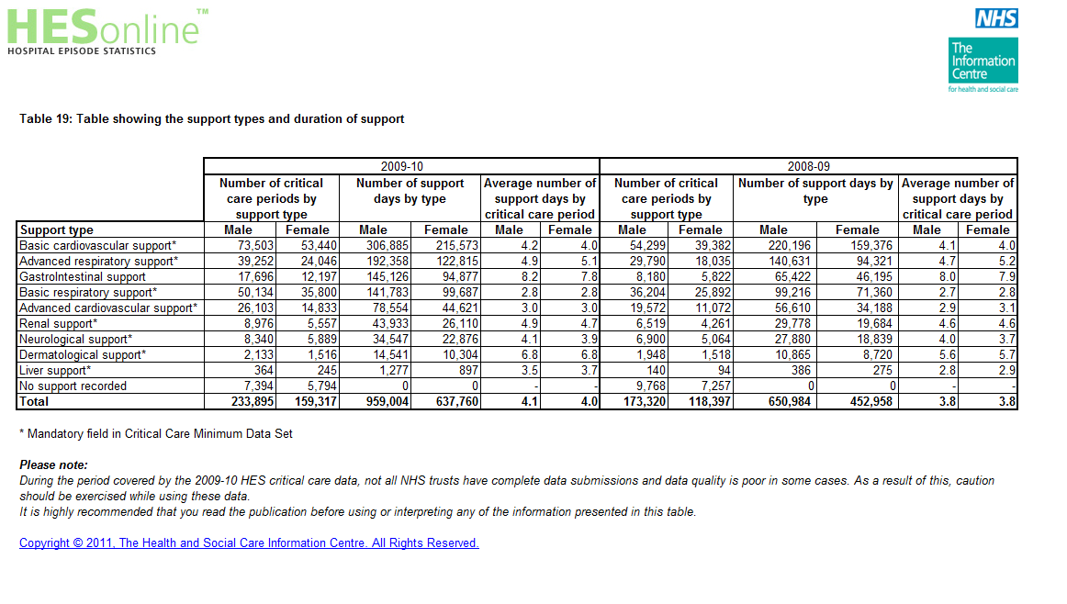
ICU

Slide 4
2008/9
140,000 ICU patients in England
48,000 cases of advanced respiratory care
x1.2 to correct for UK population
=58,000

Slide 5
ED

Slide 6
Relative rates: oversimplifying a complex issue……
Anaesthesia ICU ED
Death 16 18 4
Death +BD 19 22 5
Denominator 2.9m* 58,000** 20,000***
Incidence 1:180,000 1:3,200 1:5,000
Relative death rate 1 x56 x36
RR death +BD 1 x58 x38
*NAP4 Census
**HES ICU data 2008/9
*** Hopkinson/Benger EMJ 2010

